Slide 1


PROJECT ATTEDANCE MANAGEMENT SYSTEM
Presented by:
ARADHYA SINGH
500087235
R2142201806

Slide 2
The Attendance Management System Project is software that is used in schools, companies to track daily employee attendance. It makes it easier to find out about a certain employee’s attendance in a specific class.
The operators, who are given by the teacher for a particular class, sort the data. This method will also help in determining a employee eligibility for attendance.
The goal of creating an Attendance Management System in Java is to automate the traditional method of taking attendance. Another reason for creating this program was to be able to generate a bespoke report at the conclusion of the session or in the middle of it. Another objective for creating this project is to improve our ability to learn and apply what we’ve learned in the required area.

Slide 3
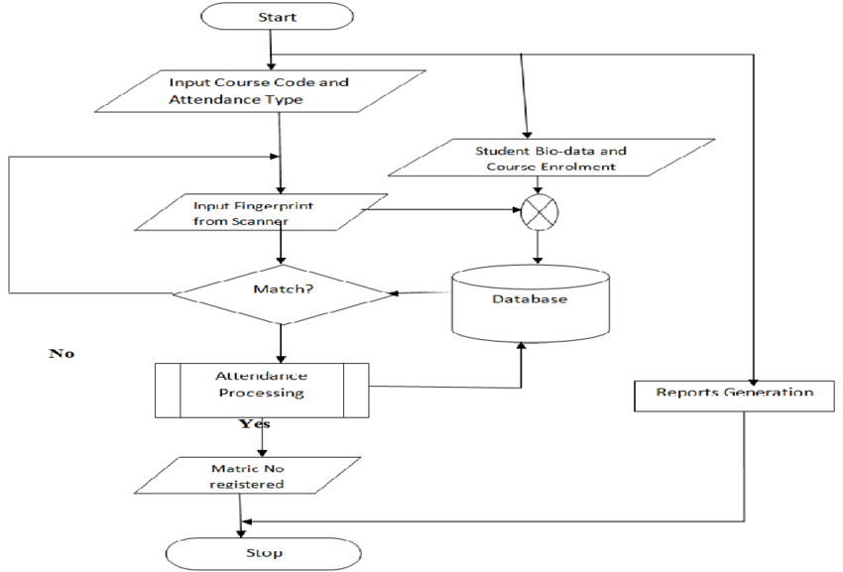
FLOWCHART

Slide 4
DISADVANTAGES OF PRESENT WORKING SYSTEM
Not User Friendly: The existing system is not user friendly because the retrieval of data is very slow and data is not maintained efficiently.
Difficulty in report generating: We require more calculations to generate the report so it is generated at the end of the session. And the student not get a single chance to improve their attendance
Manual control: All calculations to generate report is done manually so there is greater chance of errors.
Lots of paperwork: Existing system requires lot of paper work. Loss of even a single register/record led to difficult situation because all the papers are needed to generate the reports.
Time consuming: Every work is done manually so we cannot generate report in the middle of the session or as per the requirement because it is very time consuming.

Slide 5
ADVANTAGES OF THE PROPOSED SYSTEM
User Friendly: The proposed system is user friendly because the retrieval and storing of data is fast and data is maintained efficiently. Moreover the graphical user interface is provided in the proposed system, which provides user to deal with the system very easily.
Reports are easily generated: reports can be easily generated in the proposed system so user can generate the report as per the requirement (monthly) or in the middle of the session. User can give the notice to the students so he/she become regular.
Very less paper work: The proposed system requires very less paper work. All the data is feted into the computer immediately and reports can be generated through computers. Moreover work becomes very easy because there is no need to keep data on papers.
Computer operator control: Computer operator control will be there so no chance of errors. Moreover storing and retrieving of information is easy. So work can be done speedily and in time.

Slide 6
USE OF THREADS IN ATTWNDANCE MANAGEMENT SYSTEM
In an attendance management system, thread programming can be used to improve the system's performance by allowing multiple tasks to run concurrently. Here are some steps to incorporate thread programming in an attendance management system:Identify the tasks that can run concurrently:
In an attendance management system, there can be several tasks that can run concurrently, such as reading data from a database, processing attendance records, and generating reports.Create threads for each task:
Once the concurrent tasks are identified, create threads for each of them. Each thread should be responsible for executing a specific task.Manage thread synchronization:
Since multiple threads will be accessing the same data in the attendance management system, it is important to ensure that there are no data inconsistencies. This can be achieved through thread synchronization techniques such as mutexes, semaphores, and locks.
Implement thread pooling:
Thread pooling can be used to minimize the overhead of creating and destroying threads. Instead of creating a new thread for each task, a pool of threads can be created and the tasks can be assigned to the available threads in the pool.
Test and optimize: After implementing thread programming in the attendance management system, test the system thoroughly to identify any performance bottlenecks. Optimize the system by adjusting thread pool size, thread priorities, and thread synchronization techniques as necessary.

Slide 7

THANK
YOU

